Slide 1



Linear programming
An area of relatively recent development in Mathematics, and one which has a financially important application, is that of linear programming
It is a method for maximising or minimising variables, subject to constraints.
This can be applied to maximising profit, given constraints on time, material & money
Or applied to minimising costs, given constraints
Eg Al is buying some cows and sheep for his farm.
He buys c cows at £120 each
He buys s sheep at £200 each.
He wants at least 10 animals in total.
He wants more sheep than cows.
He has a maximum of £1800 to spend.
Write down three inequalities involving c and s
By the end of the module you will know how to find a possible combination of cows and sheep that satisfies all 3 inequalities.

Slide 2
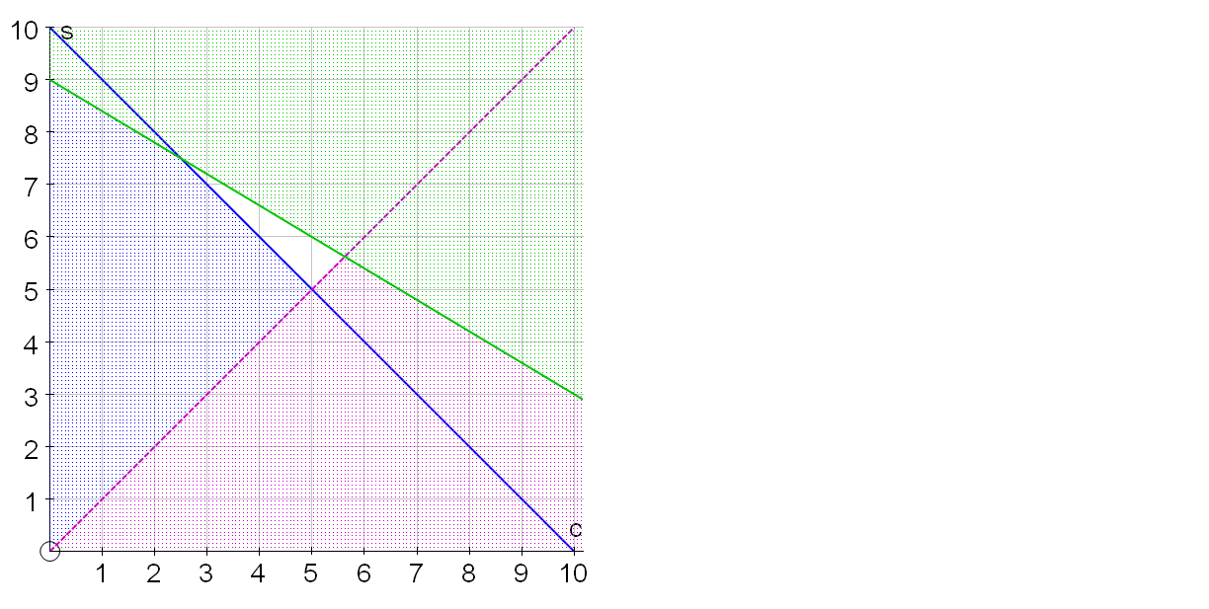


Linear programming
We will look in more detail about how to sketch inequalities, but for now, just to give an overall sense of the purpose of the method…
Eg from previously
Al is buying c cows and s sheep for his farm.
Three inequalities involving c and s are:
What possible combinations could Al buy?
Al can sell the produce of each cow for £150 and the produce of each sheep for £450.
How many of each should he buy to maximise his profit?
Cows | Sheep | Profit
3 7
£3600
4 6
£3300
5 6
£3450

Slide 3








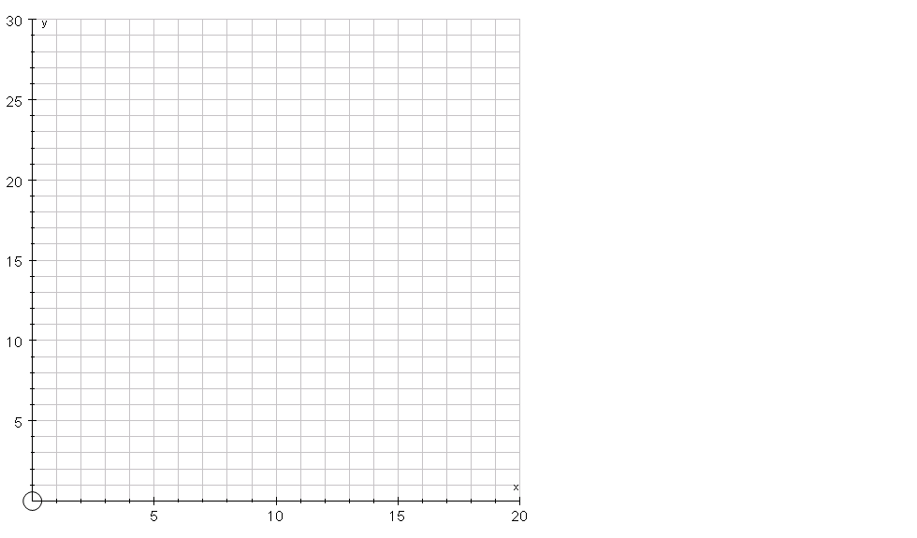














Sketching regions
Eg find the region that satisfies the inequalities:
so eliminate above the line
Eliminate below the line as
If we want eliminate below the line
so eliminate above the line
Then plot these lines using:
Either use intercept and gradient to plot
Or find where each line intersects the axes
First identify the lines of the boundaries of each region by replacing inequality signs with equals signs
Test a coordinate not on the line to see which side satisfies the inequality
Gradient = 2, Intercept = 0
Horizontal line through 6
Test a coordinate not on the line
Test a coordinate not on the line
Test a coordinate not on the line

Slide 4
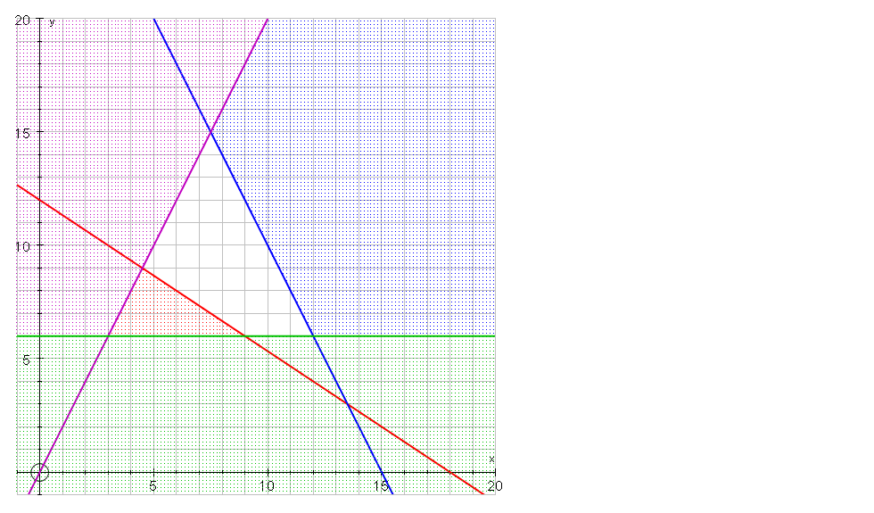



Eg find the coordinates of the vertices of the feasible region below
A is at the intersection of:
(1)
(2)
A
Sub (1) in (2):
Sub x = 7.5 in (1):
R
So A has coordinates (7.5,15)

Slide 5


Eg find the coordinates of the vertices of the feasible region below
B is at the intersection of:
(1)
(2)
Sub (1) in (2):
R
So B has coordinates (12,6)
B

Slide 6


Eg find the coordinates of the vertices of the feasible region below
C is at the intersection of:
(1)
(2)
Sub (1) in (2):
R
So C has coordinates (9,6)
C

Slide 7



Eg find the coordinates of the vertices of the feasible region below
D is at the intersection of:
(1)
(2)
Sub (1) in (2):
Sub x = 4.5 in (1):
R
D
So D has coordinates (4.5,9)

Slide 8
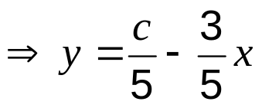





In linear programming, you need to be able to draw the line of an equation where, effectively, the intercept is a variable. Consider:
so the gradient is and the intercept is
ie you know the gradient but not the intercept
The intercept is a function of c
As c is varied, so will the intercept, but not the gradient
Watch the demo!
Whatever the value of c, you get parallel lines
So to draw , draw any line with a gradient of

Slide 9
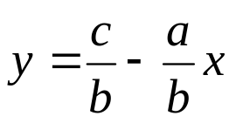
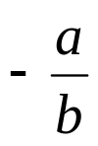

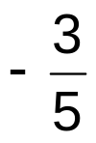
If
then
and the line will have gradient
This means
a
b
Eg
has gradient
3
When drawing this, we could imagine triangles repeatedly,
or use a larger similar triangle like:
5
12
or
300
20
500
Depending on the scale of the axes, this may be a lot faster for accurately sketching a line

Slide 10
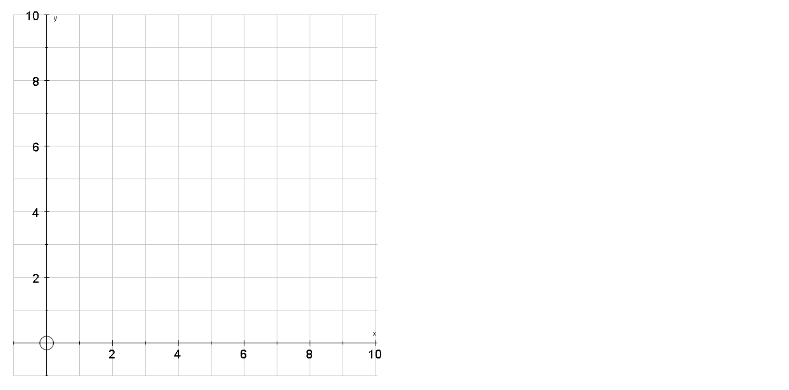
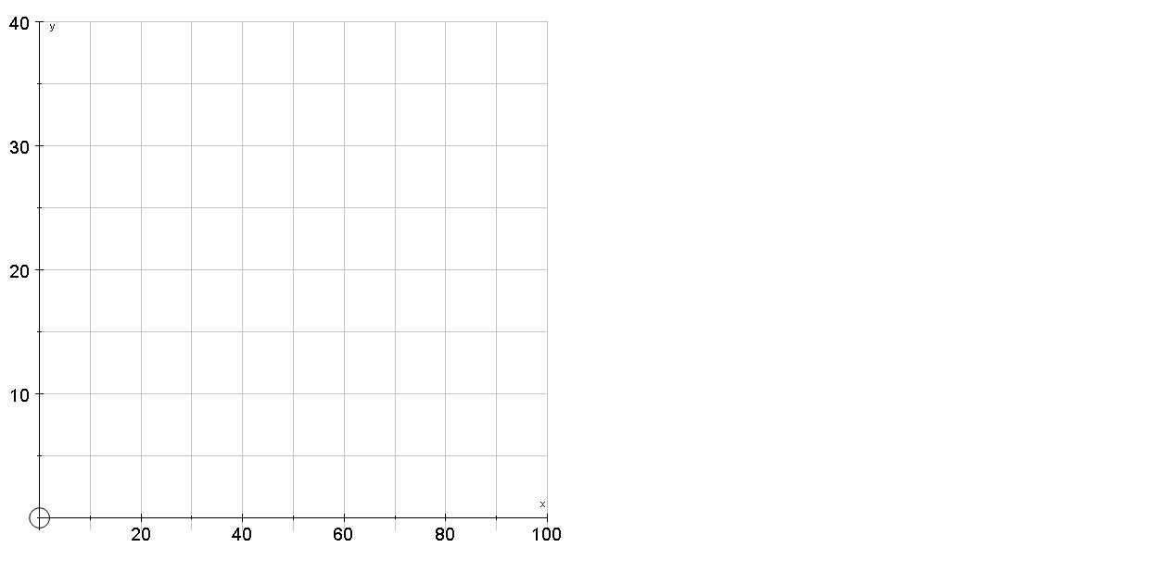
Eg show a suitable line, for each axes, of the equation
3
use
30
3
use
6
5
50
5
10

Slide 11
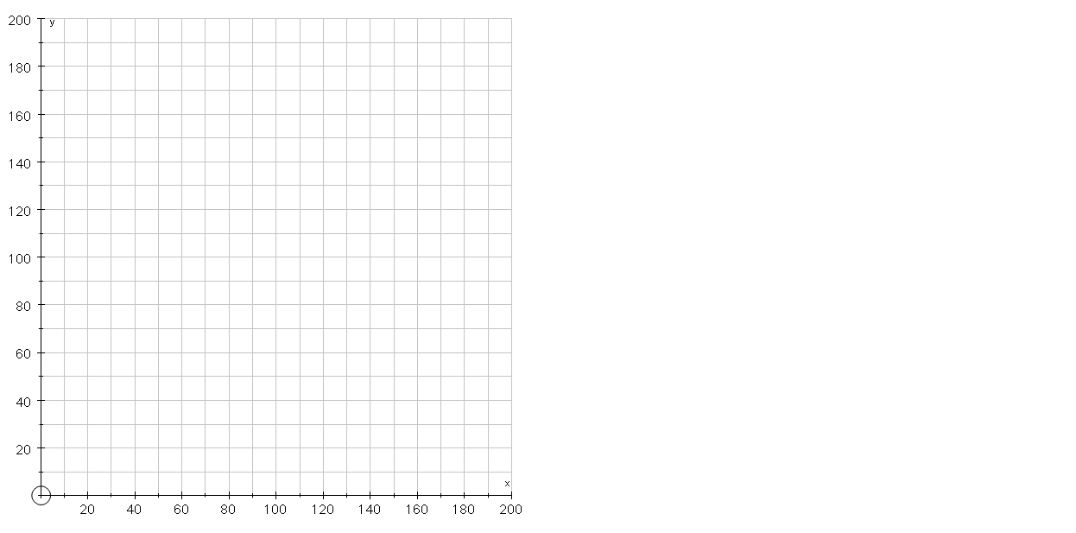







Eg John makes £1 profit for every chocolate brownie he sells and £2 for every muffin. Using x as the number of brownies he sells and y as the number of muffins he sells, write an equation for his total profit P
If he needs to make a profit of £240, what combination could he sell?
If he needs to make a profit of £120, what combination could he sell?
If he needs to make a profit of £180, what combination could he sell?
To increase profit, move the objective line away from the origin
(0,60), he sells no brownies and 60 muffins
(20,50), he sells 20 brownies and 50 muffins
(40,40), he sells 40 brownies and 40 muffins
(60,30), he sells 60 brownies and 30 muffins
(80,20), he sells 80 brownies and 20 muffins
(100,10), he sells 100 brownies and 10 muffins
(120,0), he sells 120 brownies and no muffins

Slide 12

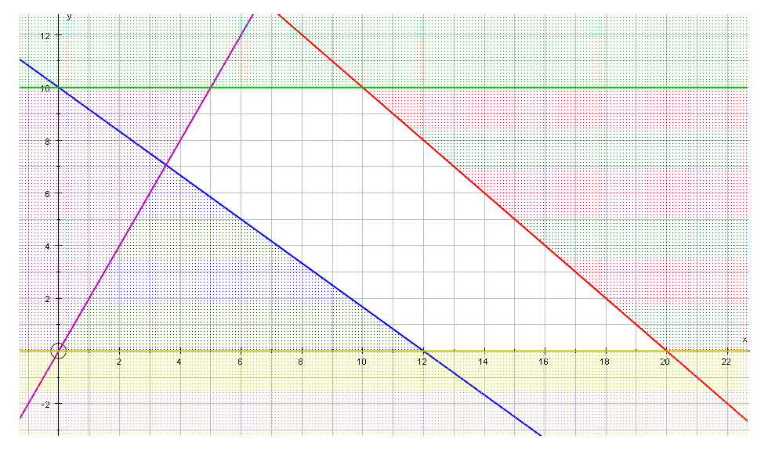
Eg The feasibility region of a linear programming problem is given below. Use the objective line method to identify the optimum solution if the aim is to:
Maximise
The optimum solution is:
x = 10, y = 10, P = 30
Increase the profit by imagining the line sliding away from the origin, keeping it parallel
Draw a ‘suitable’ line with the correct gradient
The optimum point is the last value within the critical region
1
use
10
2
20

Slide 13

Eg The feasibility region of a linear programming problem is given below. Use the objective line method to identify the optimum solution if the aim is to:
Maximise
Draw a ‘suitable’ line with the correct gradient
Increase the profit by imagining the line sliding away from the origin, keeping it parallel
The optimum solution is:
x = 20, y = 0, N = 60
The optimum point is the last value within the critical region
3
use
12
1
4

Slide 14

Eg The feasibility region of a linear programming problem is given below. Use the objective line method to identify the optimum solution if the aim is to:
Minimise
The optimum solution is not a whole number and we need to solve simultaneous equations to find their values
Minimise by imagining the line sliding towards the origin, keeping it parallel
The optimum point is the last value within the critical region
Draw a ‘suitable’ line with the correct gradient
200
use
12
200
12

Slide 15


The fact that the optimal point is always a vertex of the feasibility region gives rise to a second method of identifying the optimal point called vertex testing
With this method, we find the value of the objective function at every vertex.
For maximise problems, we then identify the vertex that gives the largest value
For minimise problems, we then identify the vertex that gives the smallest value
Eg previously used
Identify the optimum point and value if the aim is to:
Maximise M = x + y
Minimise N = x + 3y
A(7.5,15)
Vertex | M = x + y | N = x + 3y
A(7.5,15)
B(12,6)
C(9,6)
D(4.5,9)
D(4.5,9)
22.5
52.5
18
30
B(12,6)
C(9,6)
15
27
13.5
31.5

Slide 16

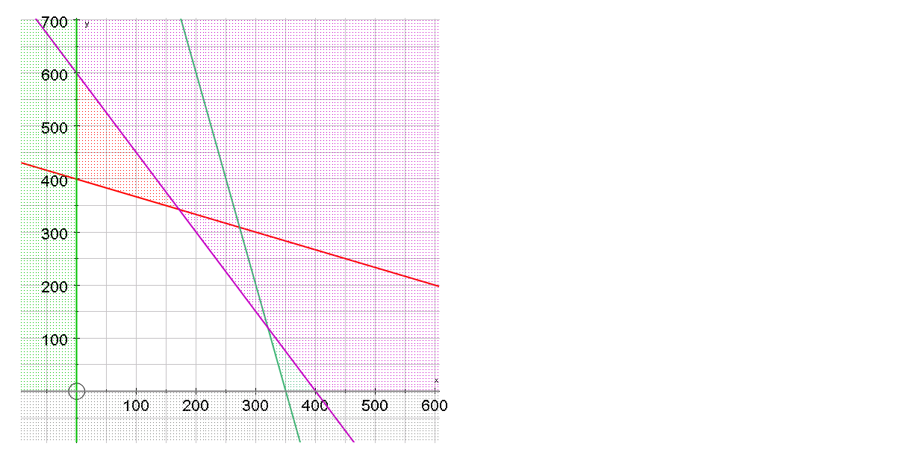



















Ex 6C, Q1
Find the optimum point and the optimum value, using:
a) the objective line method, with the objective ‘maximise ‘
2
use
400
1
200
R
Solution x = 320, y = 120

Slide 17








Ex 6C, Q1
Find the optimum point and the optimum value, using:
a) the objective line method, with the objective ‘maximise ‘
1
use
100
4
400
Solution x = 0, y = 400
R

Slide 18


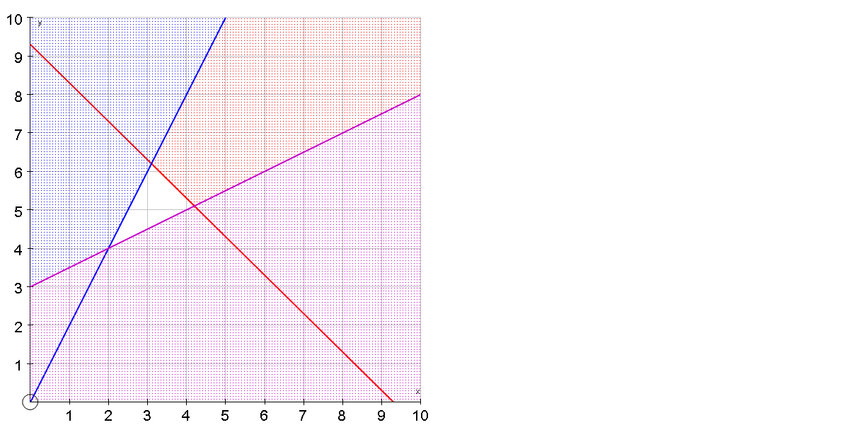
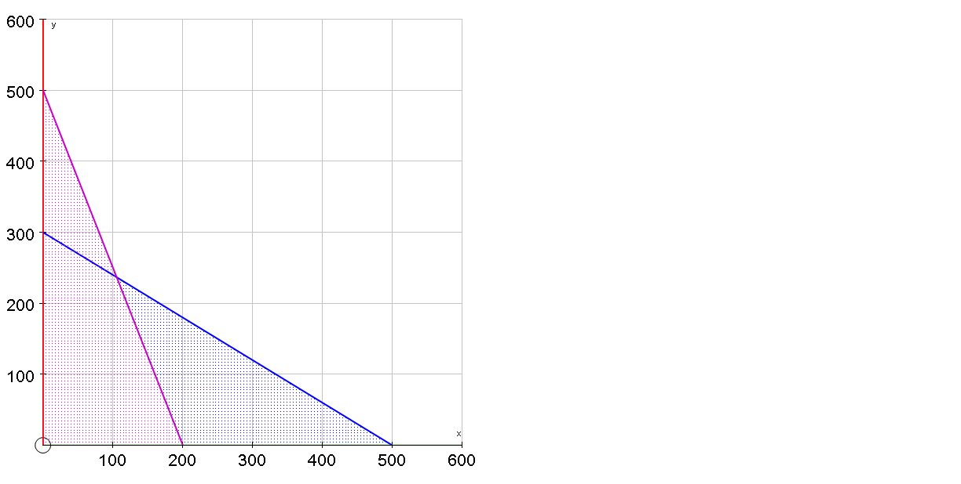


Integer value solutions
Often, solutions to linear programming problems require integer values.
There are 2 methods for doing this, depending on the scale of the graph:
Maximise
Minimise
Objective line
The closest point is obviously (3,6)
The closest point is NOT obvious…

Slide 19


























Objective line
Test 4 nearest points if integer solutions required
Point |  |  | In R?
Yes
343

Slide 20
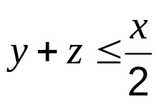

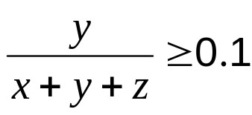


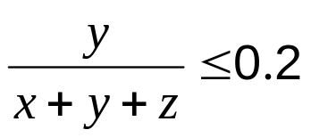


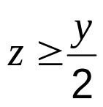




WB11 A manager wishes to purchase seats for a new cinema.
He wishes to buy three types of seat; standard, deluxe and majestic.
Let the number of standard, deluxe and majestic seats to be bought be x, y and z Standard, deluxe and majestic seats each cost £20, £26 and £36, respectively.
The manager wishes to minimise the total cost, £C, of the seats.
Constraints
He decides that the total number of deluxe and majestic seats should be at most half of the number of standard seats.
The number of deluxe seats should be at least 10% and at most 20% of the total number of seats.
The number of majestic seats should be at least half of the number of deluxe seats.
The total number of seats should be at least 250.
Non-negativity
Objective function
Minimise
Formulate this situation as a linear programming problem, simplifying your inequalities so that all coefficients are integers.

Slide 21










WB12. A company produces two types of self-assembly wooden bedroom suites, the ‘Oxford’ and the ‘York’. After the pieces of wood have been cut and finished, all the materials have to be packaged.
The table below shows the time, in hours, needed to complete each stage of the process and the profit made, in pounds, on each type of suite.
 | Oxford | York
Cutting | 4 | 6
Finishing | 3.5 | 4
Packaging | 2 | 4
Profit (£) | 300 | 500
The times available each week for cutting, finishing and packaging are 66, 56 and 40 hours respectively.
The company wishes to maximise its profit.
Let x be the number of Oxford, and y be the number of York suites made each week.
(a) Write down the objective function.
Maximise
(b) In addition to
find two further inequalities to model the company’s situation.
Cutting:
Finishing:
given
Packaging:

Slide 22


















(c) On the grid below, illustrate all the inequalities, indicating clearly the feasible region
14
12
10
8
6
4
R
2
300
use
6
0
500
10
0
2
4
6
8
10
12
14
16
18
20

Slide 23

(d) Explain how you would locate the optimal point
Profit line: draw profit line, then select point on profit line furthest from the origin
14
300
use
6
12
500
10
Furthest point (6,7)
Make 6 Oxford and 7 York
10
= £5300
8
Point testing: test corner points in feasible region,
find profit at each and select the point yielding maximum
6
4
Vertex | Profit
(0,10)
5000
2
(16,0)
4800
(6,7)
5300
0
(14,1)
0
2
4
6
8
10
12
14
16
18
20
4700

Slide 24







It is noticed that when the optimal solution is adopted, the time needed for one of the three stages of the process is less than that available.
(f) Identify this stage and state by how many hours the time may be reduced
14
Cutting:
Finishing:
12
Packaging:
10
The maximum time possible for finishing is not used in the optimum solution
8
6
So only 49 hours of finishing is required
4
Reduce the amount of time by 7 hours
2
0
0
2
4
6
8
10
12
14
16
18
20

